Slide 1
Chapter 3 part 2
Lamiae HANA

Slide 2
Second Part
Degrees of Freedom
ANOVA
Chi-Square Test
Multi-Arm Bandit Algorithm
Power and Sample Size

Slide 3

Degrees of Freedom
Notes:
Imagine you’re a fun-loving person who loves to wear hats. You couldn't care less what a degree of freedom is. You believe that variety is the spice of life. Unfortunately, you have constraints. You have only 7 hats. Yet you want to wear a different hat every day of the week.
On the first day, you can wear any of the 7 hats. On the second day, you can choose from the 6 remaining hats, on day 3 you can choose from 5 hats, and so on.
When day 6 rolls around, you still have a choice between 2 hats that you haven’t worn yet that week. But after you choose your hat for day 6, you have no choice for the hat that you wear on Day 7. You must wear the one remaining hat. You had 7-1 = 6 days of “hat” freedom—in which the hat you wore could vary!

Slide 4

Degrees of freedom are often broadly defined as the number of "observations" (pieces of information) in the data that are free to vary when estimating statistical parameters.
Degrees of Freedom = n – 1
Notes:
That’s kind of the idea behind degrees of freedom in statistics. Degrees of freedom are often broadly defined as the number of "observations" (pieces of information) in the data that are free to vary when estimating statistical parameters.
In math terms (where “n” is the number of items in your set):

Slide 5
Notes:
Now imagine you're not into hats. You're into data analysis.

Slide 6
Test the population mean with a sample of 10 values, using a 1-sample t test
Constraint
The estimation of the mean
Notes:
You have a data set with 10 values. If you’re not estimating anything, each value can take on any number, right? Each value is completely free to vary.
But suppose you want to test the population mean with a sample of 10 values, using a 1-sample t test. You now have a constraint—the estimation of the mean.

Slide 7

What is that constraint, exactly?
The sum of all values in the data must equal n x mean
Notes:
What is that constraint, exactly? By definition of the mean, the following relationship must hold: The sum of all values in the data must equal n x mean, where n is the number of values in the data set.

Slide 8
X + X + X + X + X + X + X + X + X + X = The mean x 10
10 * 3,5 = 35
mean = 3.5
In fact, the first 9 values could be anything, including these two examples:
34, -8.3, -37, -92, -1, 0, 1, -22, 99 0.1, 0.2, 0.3, 0.4, 0.5, 0.6, 0.7, 0.8, 0.9
But to have all 10 values sum to 35, and have a mean of 3.5, the 10th value cannot vary. It must be a specific number:
34, -8.3, -37, -92, -1, 0, 1, -22, 99 0.1, 0.2, 0.3, 0.4, 0.5, 0.6, 0.7, 0.8, 0.9
10TH value must be 61.3
10TH value must be 30.5
Notes:
So if a data set has 10 values, the sum of the 10 values must equal the mean x 10. If the mean of the 10 values is 3.5 (you could pick any number), this constraint requires that the sum of the 10 values must equal 10 x 3.5 = 35.
With that constraint, the first value in the data set is free to vary. Whatever value it is, it’s still possible for the sum of all 10 numbers to have a value of 35. The second value is also free to vary, because whatever value you choose, it still allows for the possibility that the sum of all the values is 35.
Therefore, you have 10 - 1 = 9 degrees of freedom. It doesn’t matter what sample size you use, or what mean value you use—the last value in the sample is not free to vary. You end up with n - 1 degrees of freedom, where n is the sample size.

Slide 9
The number of degrees of freedom equals:
.
The number of "observations"
The number of required relations among the observations
Notes:
Another way to say this is that the number of degrees of freedom equals the number of "observations" minus the number of required relations among the observations (e.g., the number of parameter estimates). For a 1-sample t-test, one degree of freedom is spent estimating the mean, and the remaining n - 1 degrees of freedom estimate variability.

Slide 10
ANOVA : Analysis of Variance
Sample
Sample
Sample
1
2
3
4
5
2
3
7
2
6
10
8
7
5
10
10
13
14
13
15
impact
impact
normal
Announced layoffs
During layoffs

Slide 11
ANOVA : Analysis of Variance
Variance
Variance
Variance
2
3
7
2
6
10
8
7
5
10
10
13
14
13
15
Sum of squares
Sum of squares
Sum of squares
Sum of squares Within groups

Slide 12
ANOVA : Analysis of Variance
Variance
Variance
Variance
2
3
7
2
6
10
8
7
5
10
10
13
14
13
15
Variance between groups
Sum of squares
Sum of squares Between Groups

Slide 13
ANOVA : Analysis of Variance
2
3
7
2
6
10
8
7
5
10
10
13
14
13
15
Variance from the mean
Total Sum of Squares

Slide 14
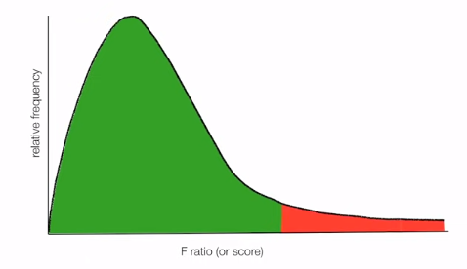
F ratio = F statistic
Fall to reject null hypothesis
Reject nul hypothesis
Rejection Region
F ratio

Slide 15

ANOVA : F statistic
2
3
7
2
6
10
8
7
5
10
10
13
14
13
15
2
3
7
2
6
10
8
7
5
10
10
13
14
13
15
Total Sum of Squares =
Sum of Squares Within Groups +
Sum of Squares Between Groups
257.3 =
54 +
203.3

Slide 16
ANOVA : F statistic
Total Sum of Squares =
Sum of Squares Within Groups +
Sum of Squares Between Groups

Slide 17
ANOVA : Analysis of Variance
Sample
Sample
Sample
2
3
7
2
6
10
8
7
5
10
10
13
14
13
15
Mean
4
8
13

Slide 18
ANOVA : Analysis of Variance
Sample
Sample
Sample
-
2
10
8
7
5
10
-
2
= -3
9
2
3
7
2
6
-
2
= 2
4
10
13
14
13
15
= -2
4
2
0
2
0
2
1
- 8
= 0
- 13
= 0
- 4
= -1
- 8
2
2
1
- 4
2
9
= -1
1
- 13
= 1
= 3
9
2
0
4
2
- 13
= 0
2
- 8
= -3
- 4
= -2
2
4
2
4
2
4
- 8
= 2
- 4
= 2
- 13
= 2
8
18
13
14
4
sum
22
∑(Observation – mean)²
Sum of squares within Groups (SSW)=
+
+
=
54

Slide 19
ANOVA : F statistic
Total Sum of Squares =
Sum of Squares Within Groups +
Sum of Squares Between Groups
54

Slide 20
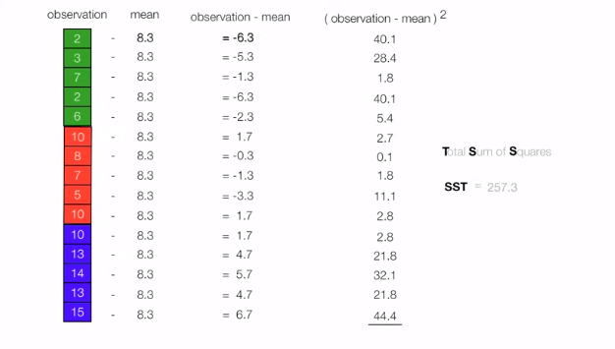

Slide 21
ANOVA : F statistic
Total Sum of Squares =
Sum of Squares Within Groups +
Sum of Squares Between Groups
257.5
54

Slide 22
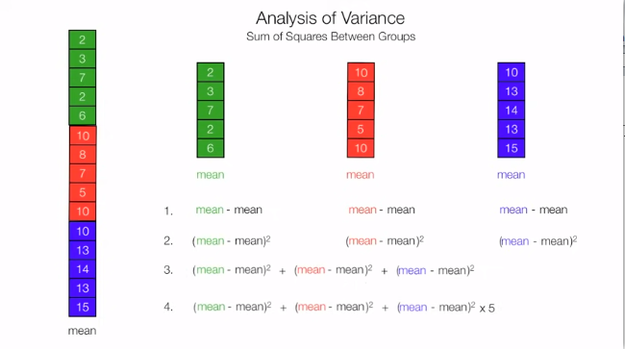

Slide 23
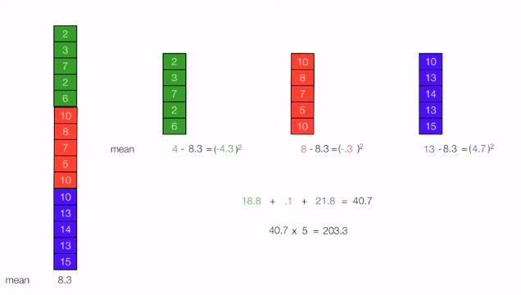

Slide 24
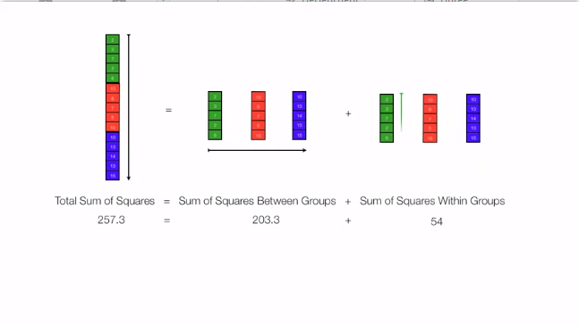

Slide 25
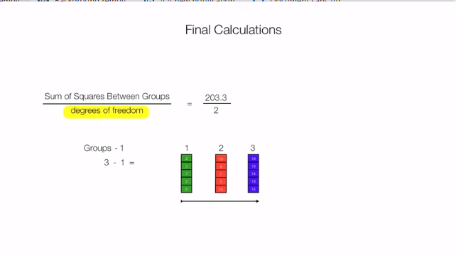
= 101.667

Slide 26
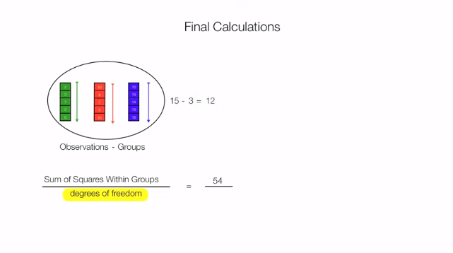
12

Slide 27
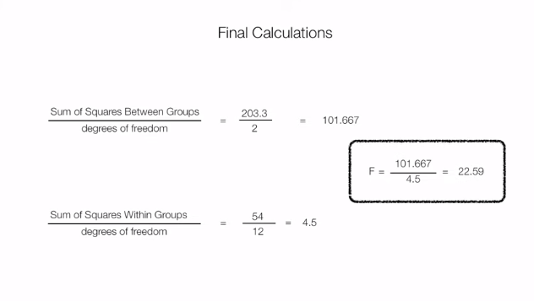

Slide 28
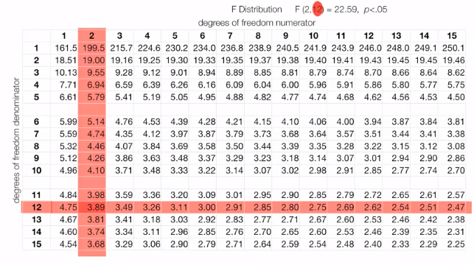

Slide 29
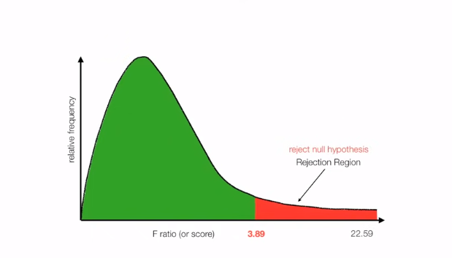

Slide 30
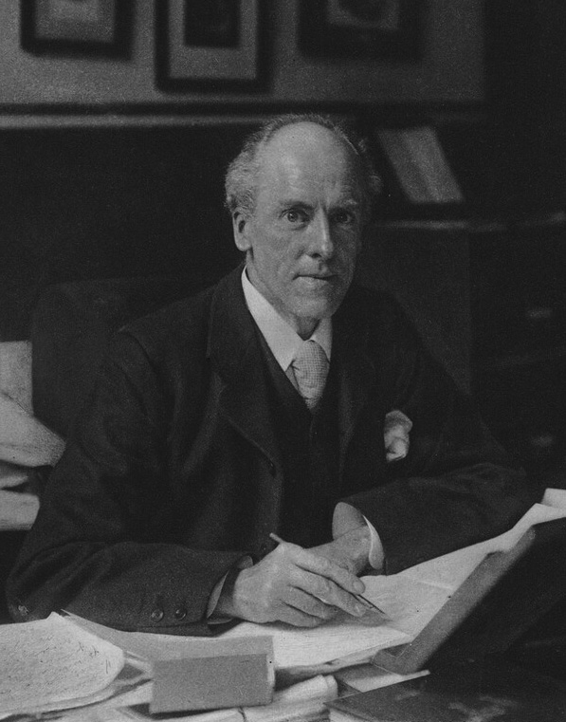
Chi-square test
Χ
Notes:
The chi-square test was originally developed by Karl Pearson in 1900. The term chi comes from the Greek letter Χ used by Pearson in the article.

Slide 31
What is a Chi-square test?

Slide 32
What is a Chi-square test?
A Chi-square test is a hypothesis testing method. Two common Chi-square tests involve checking if observed frequencies in one or more categories match expected frequencies.
What are my choices?

Slide 33
Chi-square test
Chi-square goodness of fit test
Chi-square test of independence
You can use the test when you have counts of values for (1 or 2) categorical variable.

Slide 34
 | Chi-Square Goodness of Fit Test | Chi-Square Test of Independence
Number of variables | One | Two
Purpose of test | Decide if one variable is likely to come from a given distribution or not | Decide if two variables might be related or not
Example | Decide if bags of candy have the same number of pieces of each flavor or not | Decide if movie goers' decision to buy snacks is related to the type of movie they plan to watch
Hypotheses in example | H_{o}: proportion of flavors of candy are the same H_{a}: proportions of flavors are not the same | H_{o}: proportion of people who buy snacks is independent of the movie type H_{a}: proportion of people who buy snacks is different for different types of movies
Theoretical distribution used in test | Chi-Square | Chi-Square
Degrees of freedom | Number of categories minus 1 In our example, number of flavors of candy minus 1 | Number of categories for first variable minus 1, multiplied by number of categories for second variable minus 1 In our example, number of movie categories minus 1, multiplied by 1 (because snack purchase is a Yes/No variable and 2-1 = 1)

Slide 35
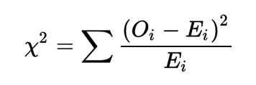


Slide 36
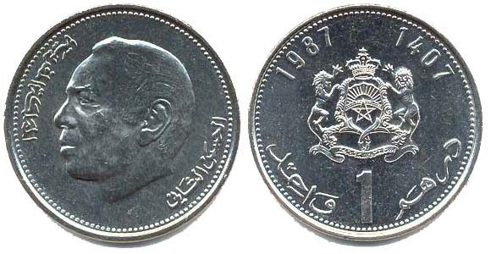
Chi-square test answer the question: is that a due to chance or something wrong with my method
100 times: 65 head and 35 tail
Null hypothesis: there is no significant difference between the observed and expected frequencies
Observed value
50 head and 50 tail
Expected value

Slide 37
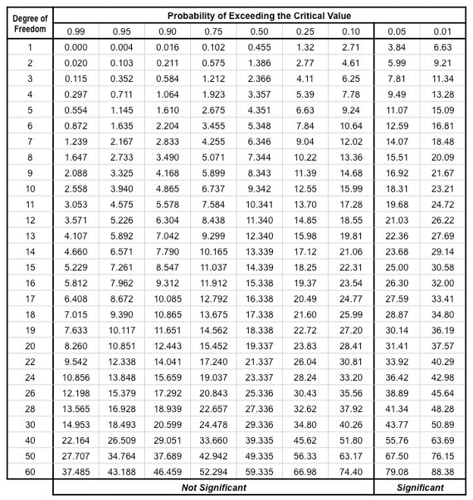
Degree of freedom = 2 – 1 = 1
Critical value we will use is 0.05
Accept
Reject

Slide 38
Multi-Arm Bandit Algorithm

Slide 39

Notes:
Do you have a favorite coffee place in town? When you think of having a coffee, you might just go to this place as you’re almost sure that you will get the best coffee. But this means you’re missing out on the coffee served by this place’s cross-town competitor.
And if you try out all the coffee places one by one, the probability of tasting the worse coffee of your life would be pretty high! But then again, there’s a chance you’ll find an even better coffee brewer. But what does all of this have to do with reinforcement learning?

Slide 40
Multi-Arm Bandit Algorithm
The dilemma in our coffee tasting experiment arises from incomplete information. In other words, we need to gather enough information to formulate the best overall strategy and then explore new actions. This will eventually lead to minimizing the overall bad experiences.
A multi-armed bandit is a simplified form of this analogy. It is used to represent similar kinds of problems and finding a good strategy to solve them is already helping a lot of industries.

Slide 41

Notes:
A bandit is defined as someone who steals your money. A one-armed bandit is a simple slot machine wherein you insert a coin into the machine, pull a lever, and get an immediate reward. But why is it called a bandit? It turns out all casinos configure these slot machines in such a way that all gamblers end up losing money!

Slide 42
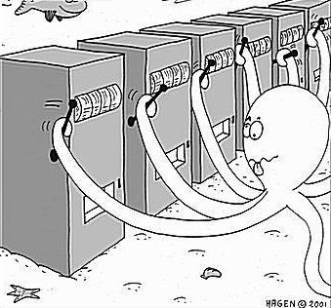
Multi-Arm Bandit Algorithm
A multi-armed bandit is a complicated slot machine wherein instead of 1, there are several levers which a gambler can pull, with each lever giving a different return. The probability distribution for the reward corresponding to each lever is different and is unknown to the gambler.
The task is to identify which lever to pull in order to get maximum reward after a given set of trials.

Slide 43
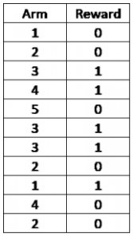
Exploration Exploitation in the context of Bernoulli MABP
The below table shows the sample results for a 5-armed Bernoulli bandit with arms labelled as 1, 2, 3, 4 and 5:
This is called Bernoulli, as the reward returned is either 1 or 0. In this example, it looks like the arm number 3 gives the maximum return and hence one idea is to keep playing this arm in order to obtain the maximum reward (pure exploitation).
Just based on the knowledge from the given sample, 5 might look like a bad arm to play, but we need to keep in mind that we have played this arm only once and maybe we should play it a few more times (exploration) to be more confident. Only then should we decide which arm to play (exploitation).

Slide 44
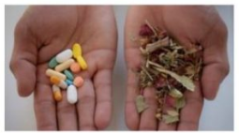
Use Cases: Clinical Trials
The well being of patients during clinical trials is as important as the actual results of the study. Here, exploration is equivalent to identifying the best treatment, and exploitation is treating patients as effectively as possible during the trial.

Slide 45

Online Advertising
The goal of an advertising campaign is to maximise revenue from displaying ads. The advertiser makes revenue every time an offer is clicked by a web user. Similar to MABP, there is a trade-off between exploration, where the goal is to collect information on an ad’s performance using click-through rates, and exploitation, where we stick with the ad that has performed the best so far.

Slide 46
Power and Sample Size

Slide 47
Power and Sample Size
If you run a web test, how do you decide how long it should run (i.e., how many impressions per treatment are needed)? Despite what you may read in many guides to web testing, there is no good general guidance—it depends, mainly, on the frequency with which the desired goal is attained.
Key Ideas
• Finding out how big a sample size you need requires thinking ahead to the statistical test you plan to conduct.
• You must specify the minimum size of the effect that you want to detect.
• You must also specify the required probability of detecting that effect size (power).
• Finally, you must specify the significance level (alpha) at which the test will be conducted.

Slide 48
References
https://blog.minitab.com/en/statistics-and-quality-data-analysis/what-are-degrees-of-freedom-in-statistics
https://www.statisticshowto.com/probability-and-statistics/hypothesis-testing/anova/
https://www.coursera.org/lecture/inferential-statistics-intro/anova-KoTvZ
https://www.analyticsvidhya.com/blog/2018/01/anova-analysis-of-variance/#:~:text=Introduction%20to%20ANOVA,-A%20common%20approach&text=Analysis%20of%20variance%20(ANOVA)%20is,the%20means%20of%20different%20samples.
https://www.youtube.com/watch?v=lgs7d5saFFc
Support de cours: https://www.youtube.com/watch?v=WXPBoFDqNVk
https://www.analyticsvidhya.com/blog/2019/11/what-is-chi-square-test-how-it-works
https://www.youtube.com/watch?v=s1xEB9XknBI&list=PLD2EE7A6284364CA2

